Slide 1
Introduction
Although the storage capacities of hard drives have increased massively over the years, access speeds—the rate at which data can be read from drives— have not kept up.
One typical drive from 1990 could store 1,370 MB of data and had a transfer speed of 4.4 MB/s, so you could read all the data from a full drive in around five minutes.
Over 20 years later, 1-terabyte drives are the norm, but the transfer speed is around 100 MB/s, so it takes more than two and a half hours to read all the data off the disk.
This is a long time to read all data on a single drive—and writing is even slower.
These specifications are for the Seagate ST-41600n.

Slide 2
Introduction
The obvious way to reduce the time is to read from multiple disks at once. Imagine if we had 100 drives, each holding one hundredth of the data. Working in parallel, we could read the data in under two minutes.
Using only one hundredth of a disk may seem wasteful. But we can store 100 datasets, each of which is 1 terabyte, and provide shared access to them.
New Problems

Slide 3
Introduction
The first problem to solve is hardware failure: as soon as you start using many pieces of hardware, the chance that one will fail is fairly high.
A common way of avoiding data loss is through replication: redundant copies of the data are kept by the system so that in the event of failure, there is another copy available.
This is how RAID (Redundant Array of Independent Disks) works, for instance, although Hadoop’s filesystem, the Hadoop Distributed Filesystem (HDFS), takes a slightly different approach, as you shall see later.

Slide 4
Introduction
The second problem is that most analysis tasks need to be able to combine the data in some way, and data read from one disk may need to be combined with data from any of the other 99 disks.
Various distributed systems allow data to be combined from multiple sources, but doing this correctly is notoriously challenging.
MapReduce provides a programming model that abstracts the problem from disk reads and writes, transforming it into a computation over sets of keys and values. The important point for this is that there are two parts to the computation—the map and the reduce—and it’s the interface between the two where the “mixing” occurs. Like HDFS, MapReduce has built-in reliability.

Slide 5
What is HDFS?
HDFS: The Storage Foundation of Hadoop
Core Concept: HDFS (Hadoop Distributed File System) is a distributed file system designed to run on commodity hardware. Think of it as a giant, virtual hard drive built from many smaller, standard computers.
Key Characteristics:
Distributed: Data is spread across many machines.
Fault-Tolerant: Automatically recovers from hardware failures.
High-Throughput: Optimized for streaming access to large datasets (Write-Once, Read-Many).
Scalable: Can easily add more machines (nodes) to increase storage capacity.

Slide 6
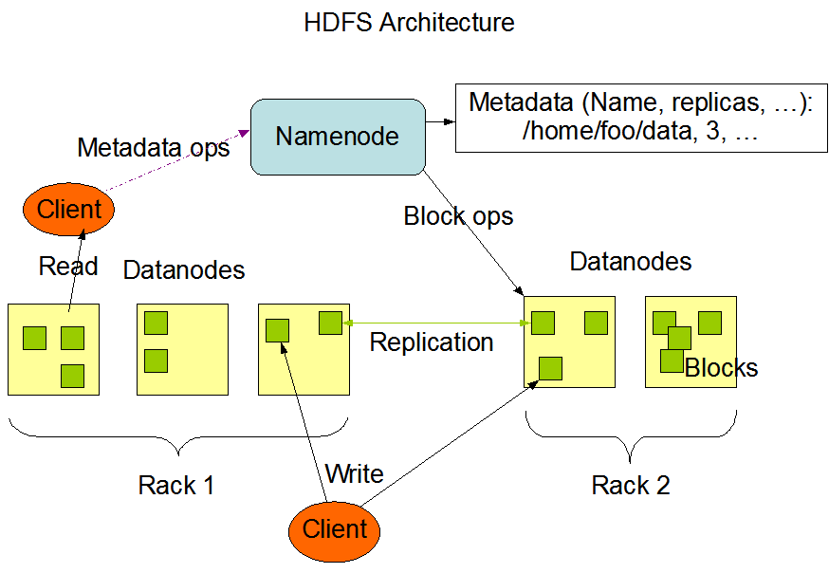
HDFS Core Components (Master/Slave)
https://hadoop.apache.org/docs/r1.2.1/hdfs_design.html

Slide 7
HDFS Core Components (Master/Slave)
The HDFS Master-Slave Architecture
1. NameNode (The Master ):
The "brain" of the file system.
Manages the file system metadata (the namespace).
It knows what files exist, where their blocks are located, and the file-to-block mapping.
Client applications talk to the NameNode for all file system operations (open, close, rename).
The NameNode does not store the actual data.

Slide 8
HDFS Core Components (Master/Slave)
The HDFS Master-Slave Architecture
2. DataNodes (The Slaves/Workers ):
The "muscle" of the file system.
Store the actual data in blocks.
Run on each worker machine in the cluster.
Constantly "check-in" with the NameNode by sending Heartbeats (to prove they are alive) and Block Reports (to list the blocks they store).

Slide 9
HDFS Core Components: Blocks
What is a Block?
  HDFS splits large files into smaller, fixed-size chunks called blocks.
  Typical Size: 128MB or 256MB (much larger than traditional file system blocks, e.g., 4KB).
Why use large blocks?
  Minimizes seek time: It's more efficient to read a large, continuous chunk of data than many small, scattered pieces.
  Reduces metadata: Fewer blocks per file means the NameNode has less metadata to manage.

Slide 10
HDFS: Fault Tolerance & Replication
Surviving Hardware Failure: Commodity hardware will fail. What happens if a DataNode (and its hard drives) dies?
The Solution: Replication
HDFS automatically copies each block to multiple DataNodes (default replication factor is 3).
Rack Awareness: The system tries to place replicas on different "racks" (physical groups of servers connected to the same network switch).
  Replica 1: On the same node as the client (if possible).
  Replica 2: On a different node in the same rack.
  Replica 3: On a node in a different rack.
Benefit: This protects data from both individual disk/machine failure and entire rack failures (e.g., a switch dying).
If a DataNode dies, the NameNode detects this (missed heartbeats) and automatically re-replicates its blocks to other live nodes.
https://hadoop.apache.org/docs/r1.2.1/hdfs_design.html

Slide 11
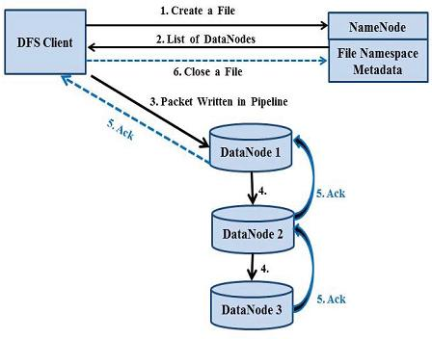
HDFS Read/Write Operations
File Write:
Client to NameNode: "I want to create file data.txt."
NameNode to Client: "OK. Start writing your blocks to DataNodes A, B, and C."
Client to DataNode A: Client writes the first block.
Replication Pipeline: DataNode A forwards the block to B, and B forwards it to C.
Acknowledgements: C -> B -> A -> Client. Once all 3 are written, the client asks the NameNode for the next block location.

Slide 12
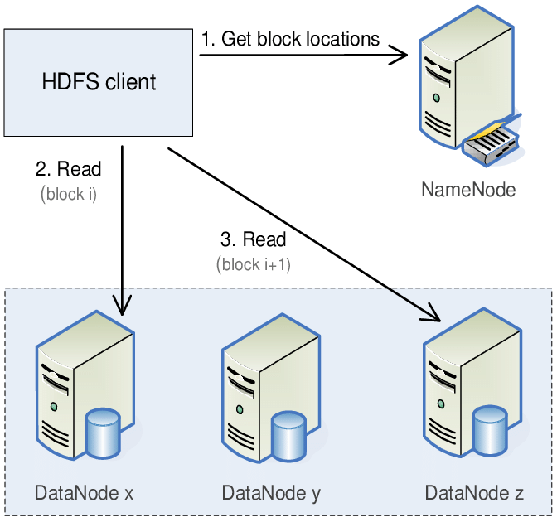
HDFS Read/Write Operations
File Read:
Client to NameNode: "Where can I read data.txt?"
NameNode to Client: "You can get Block 1 from DataNodes A, D, or F. You can get Block 2 from B, E, or G."
Client to DataNodes: The client reads the blocks directly from the DataNodes (choosing the closest one).
Key Insight: The NameNode coordinates, but the client reads/writes data directly to/from the DataNodes.

Slide 13
Limitations of HDFS
Not efficient for small files (metadata overhead)
Not suitable for low-latency data access
Write-once model limits flexibility
Scaling the NameNode is challenging (single point of failure, though HA setup mitigates)

Slide 14
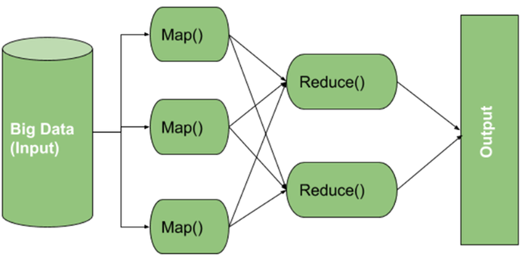
Introduction to MapReduce
Programming model for distributed data processing
Developed by Google, implemented in Hadoop
Works on “divide and conquer” principle
Input: Large dataset → Output: Aggregated result
https://www.geeksforgeeks.org/c-sharp/map-reduce-in-hadoop/

Slide 15
The MapReduce Phases
The Three Phases: Map, Shuffle, Reduce
Map Phase
Input: Data is read from HDFS as (Key, Value) pairs. Example: (line_number, "text of the line").
Logic: A user-defined map() function is applied in parallel to every input pair.
Output: Generates zero or more intermediate (Key, Value) pairs.
Shuffle & Sort Phase (The "Magic Middle")
This is handled by the framework automatically!
It collects all intermediate (Key, Value) pairs from all Mappers.
It sorts them by key.
It groups all values associated with the same key.
Output: Creates (Key, [List of Values]) pairs.

Slide 16
The MapReduce Phases
Reduce Phase
Input: The (Key, [List of Values]) pairs from the Shuffle phase.
Logic: A user-defined reduce() function is applied to each group.
Output: Generates the final (Key, Value) pairs, which are written back to HDFS.

Slide 17
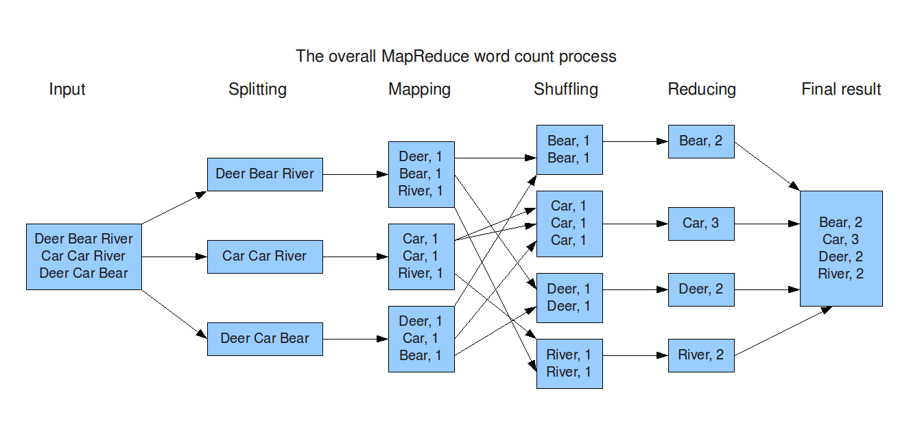
The Classic Example: Word Count

Slide 18
Limitations of MapReduce
MapReduce revolutionized large-scale batch processing, but it has significant drawbacks. Understanding these limitations is key to understanding why new tools like Apache Spark and Flink were created.
MapReduce is fundamentally a batch processing system. It is not for real-time or low-latency queries.
Why? Disk I/O is Everywhere:
It reads its initial data from HDFS (disk).
Mappers run, then write their intermediate output to the local disk.
Reducers read this intermediate data from the Mappers' disks (network + disk).
Reducers write their final output back to HDFS (disk).
Impact: This constant read/write to disk makes it very slow. It's fine for an overnight report, but terrible for an interactive dashboard.

Slide 19
Limitations of MapReduce
The Map -> Reduce model is very restrictive.
What about complex jobs?
Many real-world algorithms (like in machine learning or graph processing) require multiple steps.
Solution in MapReduce: You must chain multiple MapReduce jobs together.
Impact: This is extremely inefficient. Each step involves a full read/write cycle to HDFS, introducing massive latency.

Slide 20
Limitations of MapReduce
Many modern algorithms are iterative (e.g., K-Means clustering in machine learning).
This means the logic needs to "loop" over the data, refining the result with each pass.
MapReduce's Handling: each "loop" or "iteration" must be implemented as a brand new MapReduce job.
Impact: The data is re-loaded from HDFS on every single iteration. Caching data in memory between iterations is not part of the model. This makes iterative analytics almost unusable in pure MapReduce.
This is the main problem Apache Spark was built to solve with its in-memory DataFrames.

Slide 21
Limitations of MapReduce
Writing a "simple" MapReduce job requires a lot of boilerplate code.
What you must write:
A Mapper class
A Reducer class
A Driver class (to configure and launch the job)
Handling data types
Impact:
Low developer productivity. It takes a long time to write and debug simple logic.
This led to the creation of higher-level abstraction tools like Hive (uses SQL) and Pig (uses a simple script) that compile down to MapReduce jobs.

Slide 22
Limitations of MapReduce
Why We Moved Beyond MapReduce
MapReduce was great for:
Large-scale, one-pass batch processing.
MapReduce was bad for:
Real-time processing (High Latency)
Interactive queries (High Latency)
Iterative algorithms (ML, Graphs)
Complex multi-step logic (Rigid M->R model)
The Next Step: These limitations led directly to the development of new frameworks:
Apache Spark: For fast, in-memory, interactive, and iterative processing.
Apache Flink / Kafka Streams: For true real-time stream processing.
YARN made it possible for all these tools to co-exist on the same Hadoop cluster.

Slide 23
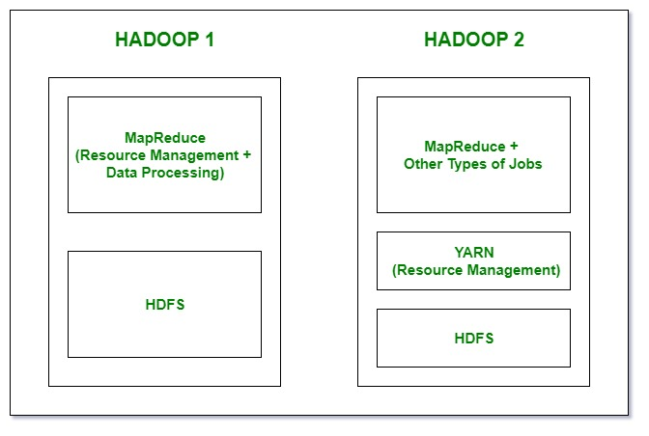
Hadoop 1 vs Hadoop 2
In Hadoop 1, HDFS is used for storage, and on top of it, MapReduce handles both resource management and data processing. Because MapReduce is responsible for these multiple tasks, it can create performance bottlenecks.
In Hadoop 2, HDFS is still used for storage, but resource management is handled by YARN instead of MapReduce. YARN manages and allocates resources efficiently, while MapReduce (and other processing frameworks) focus solely on data processing, resulting in improved performance and flexibility.

Slide 24
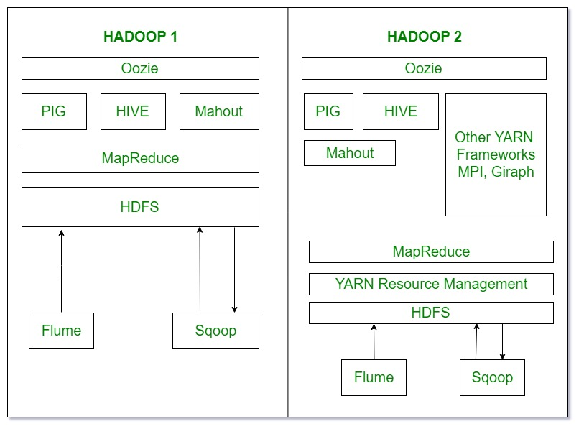
Hadoop 1 vs Hadoop 2
Hadoop 1 follows a Master-Slave architecture with a single master node. If the master node fails, the entire cluster becomes unusable, and restoring it is time-consuming.
Hadoop 2 also uses a Master-Slave architecture but supports multiple master nodes (active and standby). If one master fails, a standby master automatically takes over, eliminating the single point of failure and improving reliability.

Slide 25
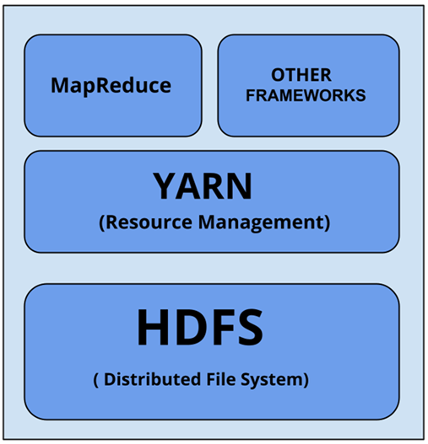
YARN (Yet Another Resource Negotiator)
YARN: The "Operating System" of Hadoop
YARN is the resource management and job scheduling component of Hadoop (introduced in Hadoop 2.0).
YARN separates the resource management (who gets what CPU/RAM) from the data processing (what code to run).
Why?
In Hadoop 1.0, the "JobTracker" did both resource management and MapReduce processing.
This was a bottleneck: It couldn't scale well and only supported MapReduce.
YARN allows Hadoop to run many different types of applications (e.g., MapReduce, Spark, Flink, Tez) on the same cluster.

Slide 26
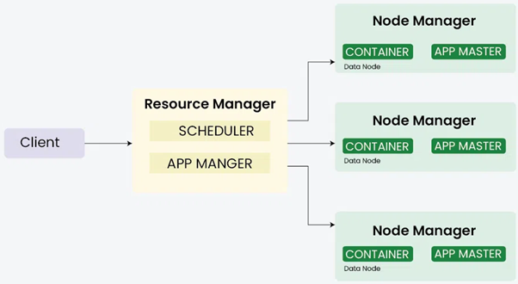
YARN Core Components
ResourceManager (The Global Master):
The single, ultimate authority for all cluster resources.
Runs on a master node.
Has two main parts:
  Scheduler: The "allocator." Decides which application gets which resources based on policies (like FIFO, Capacity, or Fair). It is a pure scheduler; it doesn't monitor tasks.
  ApplicationManager: Manages the lifecycle of all applications, including starting their ApplicationMaster.
https://www.geeksforgeeks.org/data-engineering/explain-the-role-of-yarn-yet-another-resource-negotiator-in-hadoop/

Slide 27
YARN Core Components
NodeManager (The Slave/Worker, 1 per node):
Runs on every worker node (alongside the HDFS DataNode).
The "on-site manager" for that specific machine.
Responsibilities:
  Reports its node's health and available resources (CPU, RAM) to the ResourceManager.
  Manages Containers on its node (launching, monitoring, and killing them).

Slide 28
YARN Application Components
ApplicationMaster (The "Per-Job" Master):
There is one ApplicationMaster (AM) created for every single job submitted to the cluster.
Responsibilities:
  Negotiates with the ResourceManager's Scheduler for resources (i.e., "I need 20 containers with 2GB RAM each").
  Receives the containers from the RM.
  Monitors its own tasks, tracks their progress, and handles failures.

Slide 29
YARN Application Components
Container (The "Work Unit"):
A bundle of resources (CPU, RAM) on a specific NodeManager.
This is where the actual application code (like a Map task or a Reduce task) runs.
A container is just a reservation; the ApplicationMaster decides what code to run inside it.

Slide 30
YARN Workflow
Client submits job to ResourceManager
RM launches ApplicationMaster
AM requests containers (resources) from RM
RM allocates containers on NodeManagers
AM launches tasks inside those containers
Tasks execute → send progress to AM → AM updates RM

Slide 31
Advantages of YARN
Multi-tenancy: Supports multiple frameworks (MapReduce, Spark, Tez, etc.)
Improved scalability & cluster utilization
Better fault tolerance & flexibility
Decoupled processing model enables new computation engines

